Slide 1
Graphs of PSO and CNN
Louis, Albert, Sweta

Slide 2
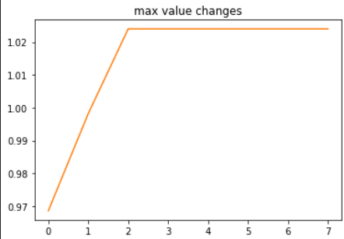
PSO max changes (x is not iteration)

Slide 3
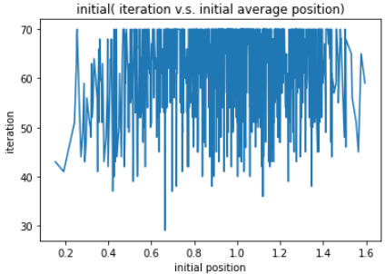
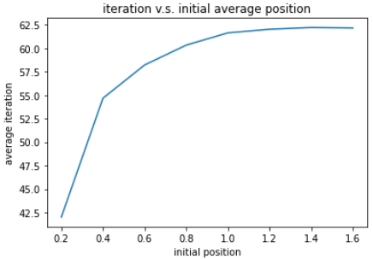
PSO iteration v.s. distance from max

Slide 4
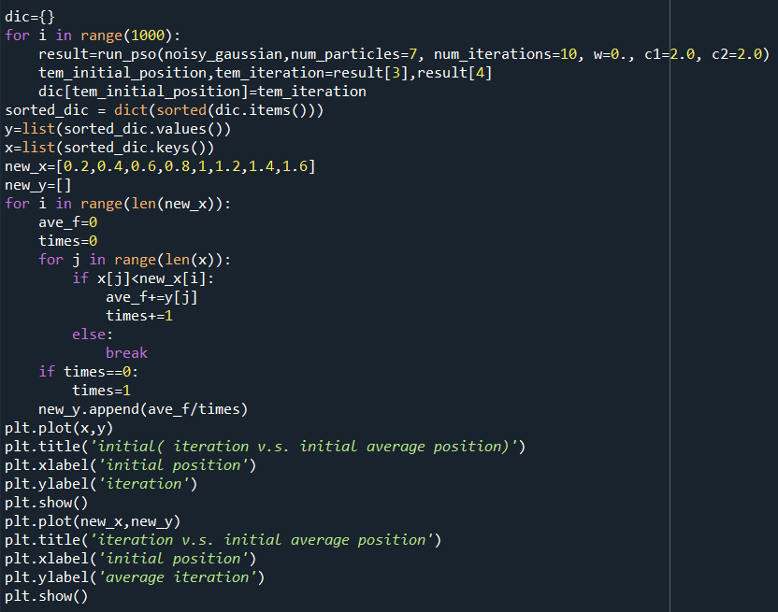

Slide 5
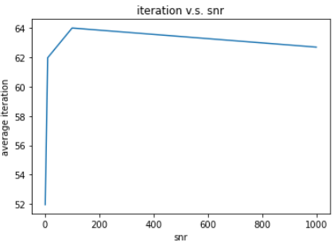
PSO iteration v.s. SNR
Jump to 7th

Slide 6
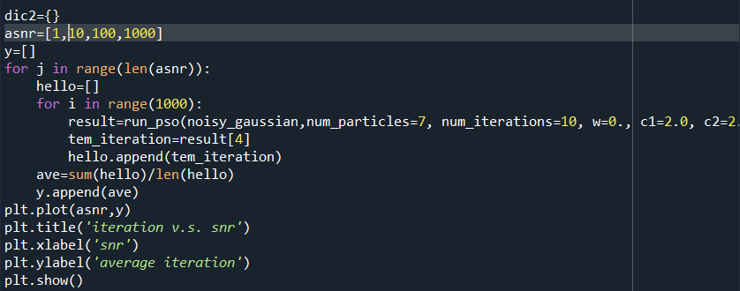

Slide 7
Question
How to judge if the search method is good or not?
Gaussian value?
Final position?
Maybe it could explain the increase of SNR graph

Slide 8
CNN

Slide 9
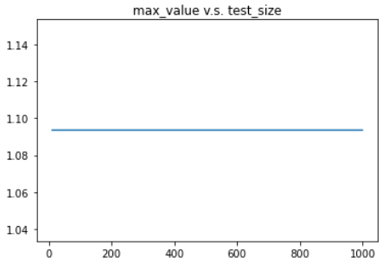
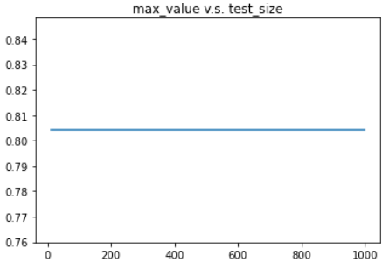
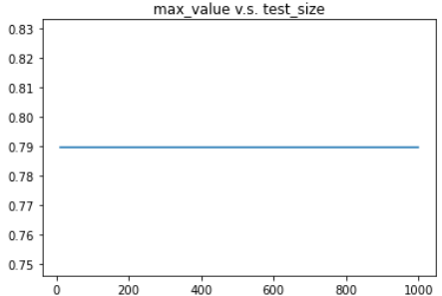
CNN Max values v.s. test sizes
Highly depend on training data
Use 1000 training data

Slide 10
PSO-----------------------------CNN
PSO changes a lot in same condition
PSO is Efficient in no prior training data
No training process
Good Output

